Slide 1

A PROJECT REASERCH.
SUBMITTED BY:
Irene Juma
21-2161

Slide 2

HOUSE PRICING PREDICTION

Slide 3
INTRODUCTION
There are so many problems faced while buying a house which is a very stressful
thing, this is because many factors are involved when deciding to buy a house.
Therefore;
The project is aimed at helping property investors to know the trend of housing prices
in certain areas.
And also aimed at helping people who plan to buy a house or houses to know the
range of prices in the future in order for them to plan their finances well.
By creating an effective price prediction, I will be able to bring solution to many people
who have plans of buying houses.
Linear regression algorithm is used to train and test the model in this project.

Slide 4
DATASET
The data set I used for my project is California housing prices. It is an effective
data and easy to deal with.
The data in the data set has various features, areas and some variables hence its
going to be a regression problem.
It is going to help us predict the house value based on the other features.
Our main focus variable will be based on the house value hence the features will be
used to predict the house value.

Slide 5
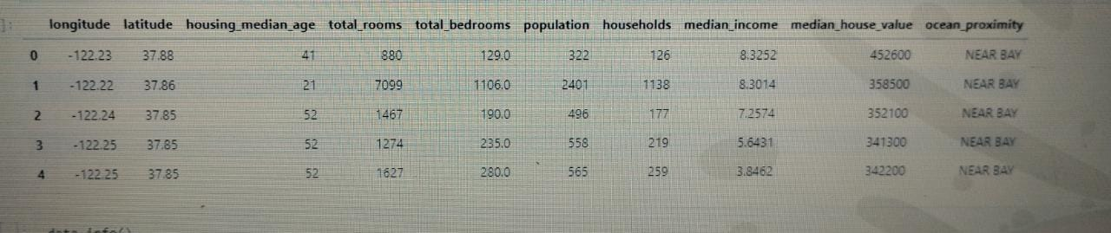
In [ ]:

Slide 6
As from the data above, those are the numbers we are going to use to find the model
Linear regression.
But from the table there are some values which cannot be used as they are like the
ocean proximity column.
As you will notice from the done project that the heat map might have some problem
this is due to the values on the ocean proximity column but has been rectified later on.
But first we can do a data exploration first which involves analysing the data and
finding out the main properties of the data set.
.
Exploration of the data set helps to familiarize with the data that we are working with.
Also helps to know the properties of a data set such as the size, accuracy and other
properties in the data.

Slide 7
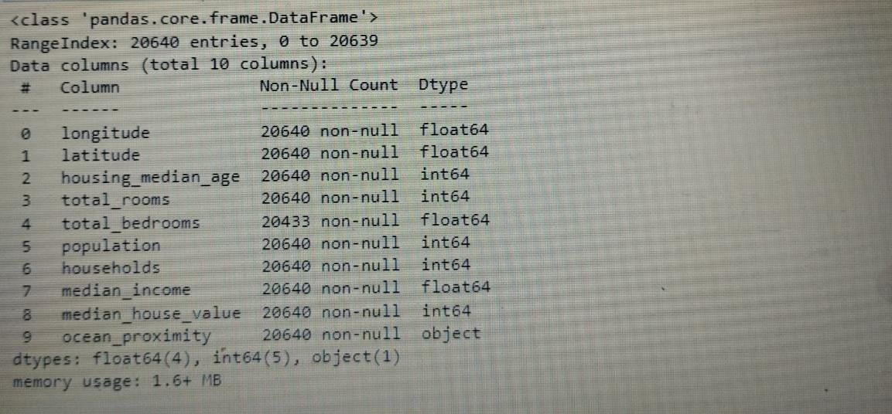

Slide 8
DATA VISUALIZATION
It is the graphical representation of information and data.
Data visualization tools provides an easier way to observe and understand trends,
outliers and patterns of data.
They are also important in analysing huge amounts of data just like from
my data set above.
It can also be referred to as information graphics, information visualization or
statistical graphs.

Slide 9
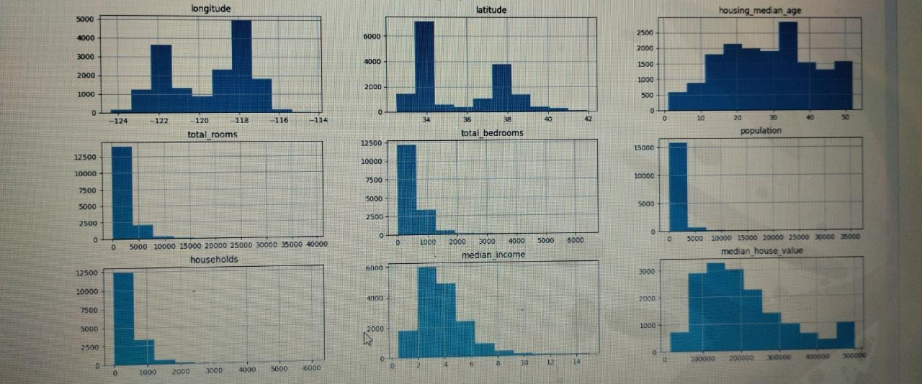

Slide 10
DATA SELECTION
This is the process of determining the most suitable data type and source as well as
an appropriate instruments to collect data.
The process of selecting an appropriate data for a project is can largely impact the
data’s integrity.
The importance of this data selection is to determine the most suitable data type and
source that helps the property investors to easily answer any research questions.
Things to be aware of when selecting data is:
a. Appropriate data and sources of data which allows investors to answer research
questions.
b. Obtain a suitable procedures in order to attain representative sample.
c. The proper instrument used to collect the data.
This determination is driven by the nature of the investigation, existing literature and
accessibility to necessary data sources.

Slide 11
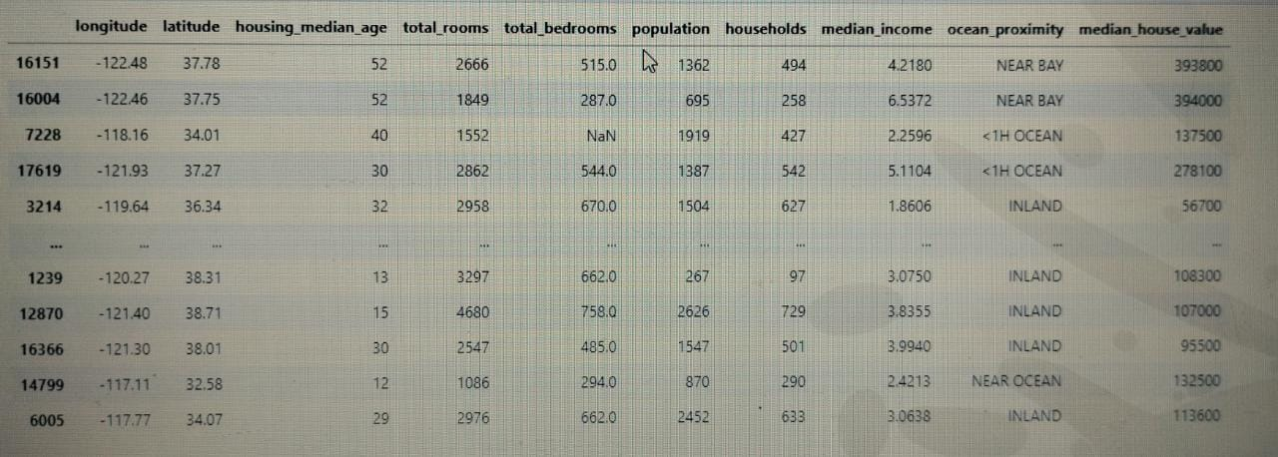

Slide 12
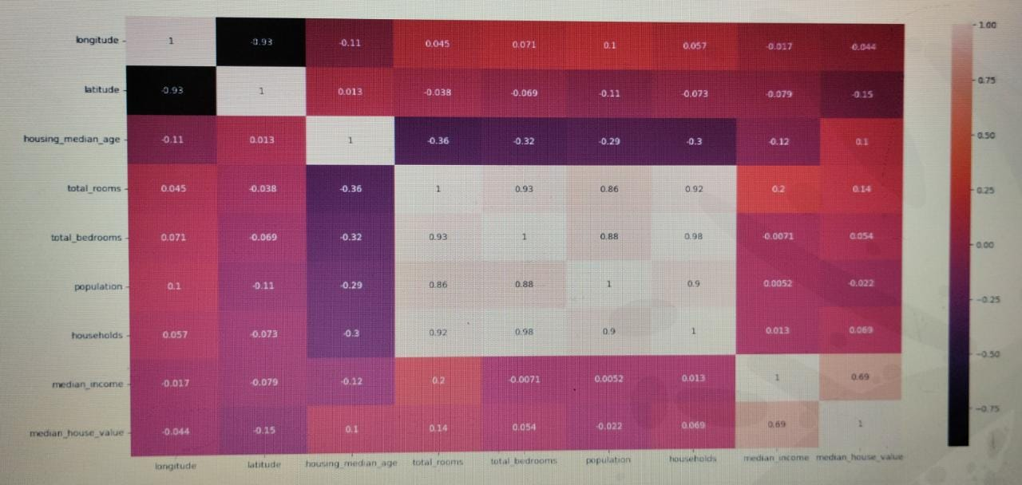
CORRELATION HEAT MAP.

Slide 13
DATA TRANSFORMATION
From slide 5, I had mentioned about there are some values that cannot be used
as they are e. g the values from the ocean proximity column from our data set.
We cannot use the letters as they are, therefore we will introduce dummy
variable.
In regression analysis, a dummy variable is one that takes the values 0 or 1 to
replace values that cannot be used to find the regression or values that may
shift the expected outcome.
After introducing the dummy variable the data to be used will be as below;

Slide 14
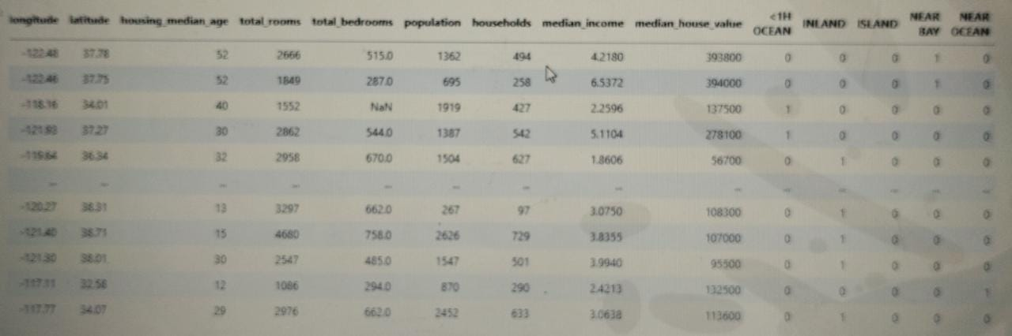

Slide 15
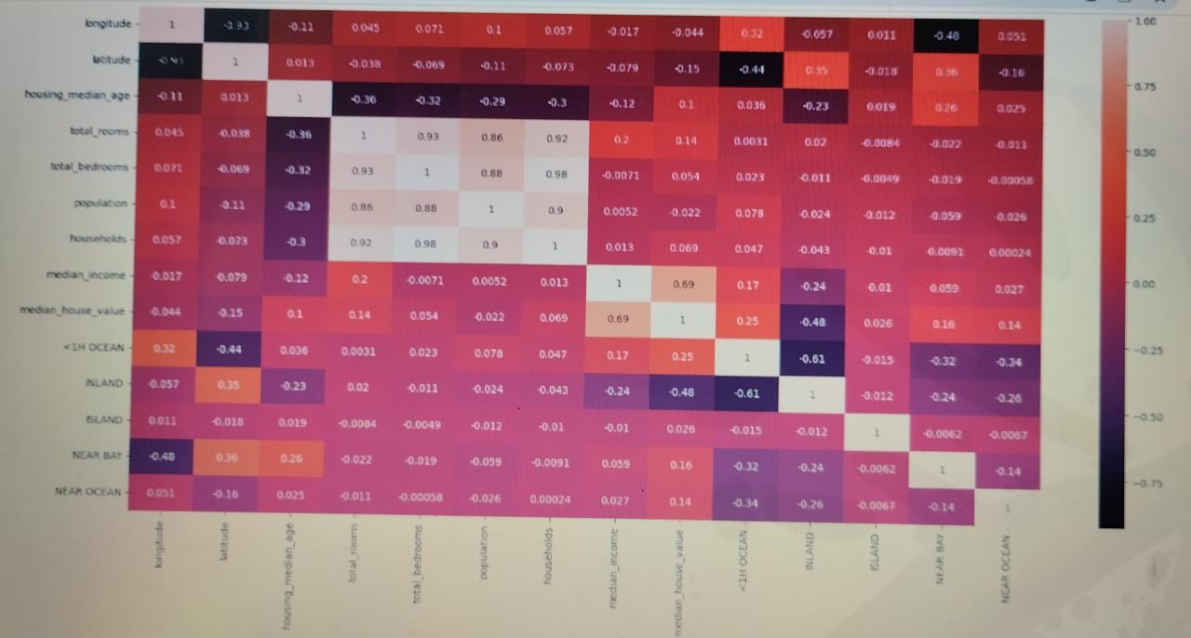
This is the transformation correlation heat map after obtaining the dummy variables
in the data above.

Slide 16
CONTINUI…
I also managed to do a scatter plots for the median income vs total bedrooms
and the other one was showing the longitude vs latitude of the areas.
A scatter plot shows what happens to one variable if another variable is change
It helps to visualize the relationship between two sets of data.
Below are the scatter plot graphs;

Slide 17
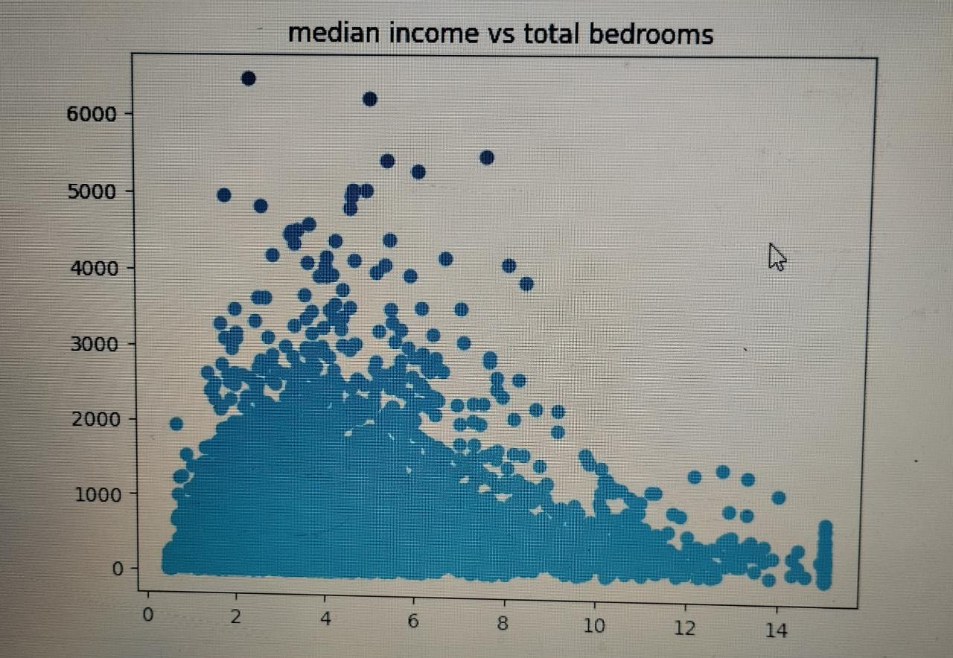

Slide 18
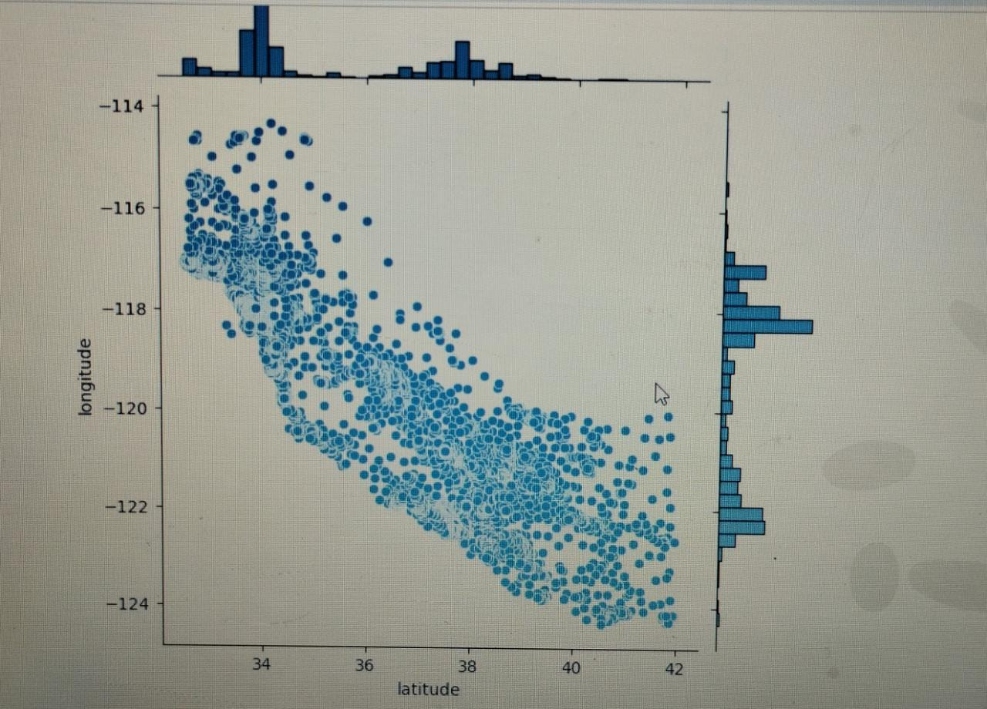

Slide 19
In conclusion, the regression that we found from all the data above was
0.852804571796.
We also realized that linear regression is the most effective model for our dataset
with the score that we have obtained .

